Slide 1
Automatyka Przemyslowa S.C.
Dariusz Lobejko, Rafał Raszewski
e-mail: biuro@apsc.pl
59-220 Legnica ul. Anielewicza 3/1b
tel. +48 76 8523919 fax. +48 76 8501727
mobile +48601768441 +48603390313 +48603390314

Slide 2
„Automatyka Przemysłowa s.c.” was founded in September, 1996. It employs today 20 control engineers and electricians. The company offers services in the scope of designing, assembling and commissioning of electrical control installations for different kinds of applications.
Until now, most of projects were addressed to automotive industry (welding shops, paint shops, assembly shops).
In the past we cooperated very often with company “ASI GmbH” from Germany.
Today our business partners are:
“Simtech Automatyka Przemyslowa” from Gliwice (Poland),
“Gamma Plus s.c.” from Austria,
“Eisenmann GmbH” from Germany.

Slide 3
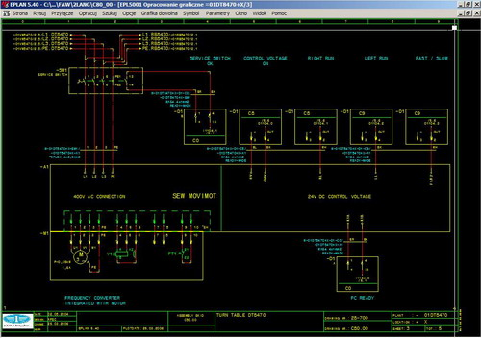
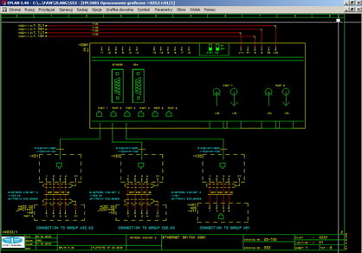
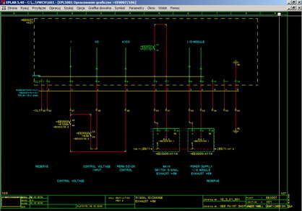
Automatyka Przemysłowa s.c.
Dariusz Łobejko, Rafał Raszewski
Control installations design (using CAE EPLAN tool)

Slide 4
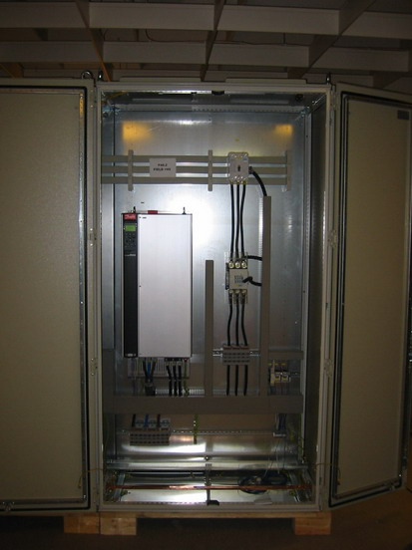
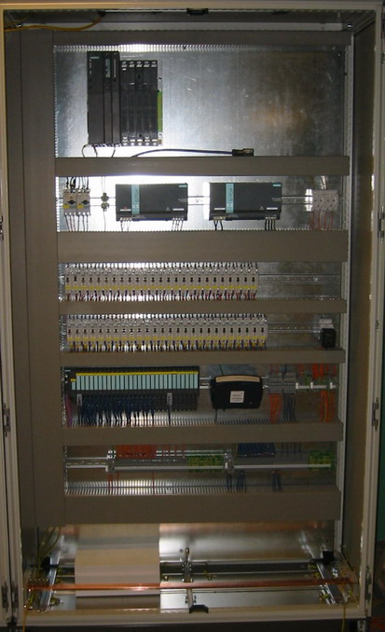
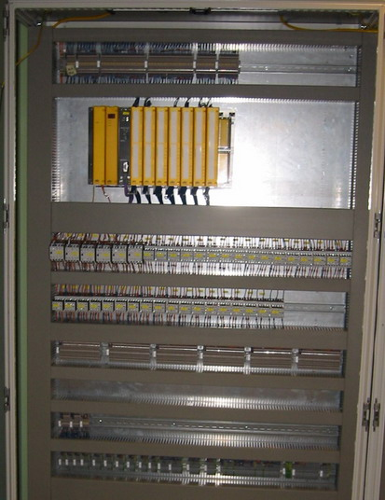
Assembly of control cabinets

Slide 5
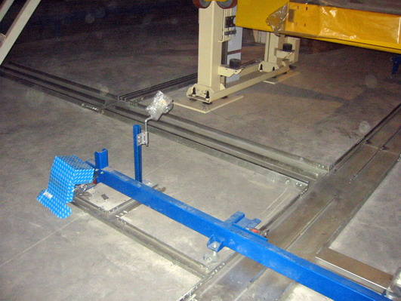
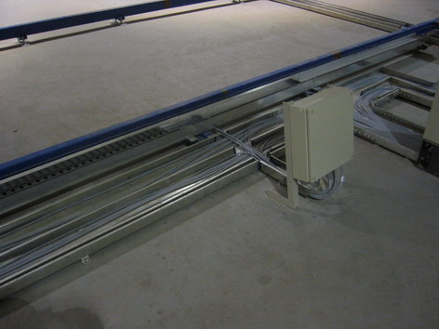
Cable trays installation
Wiring all devices on site

Slide 6
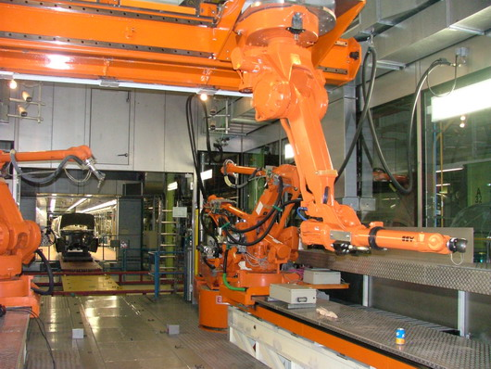
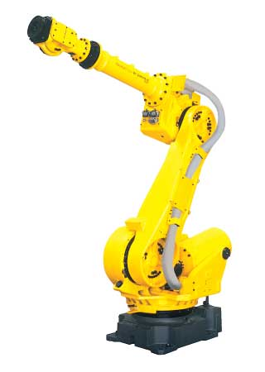
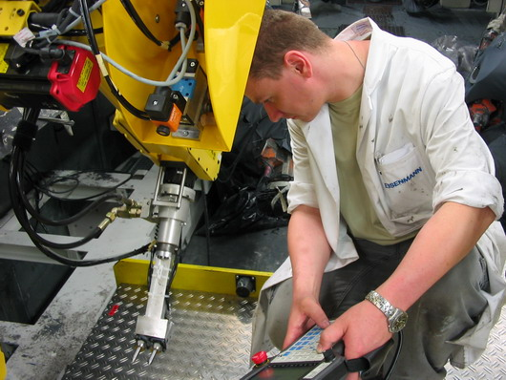
FANUC and ABB robots programming

Slide 7
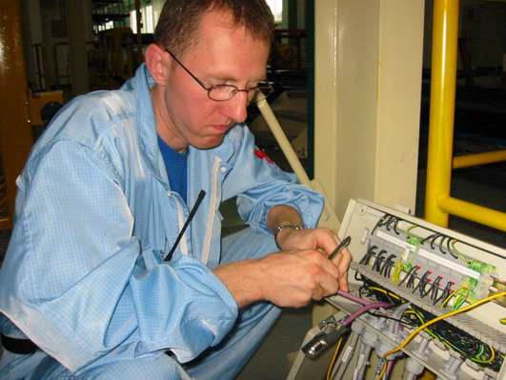
Start-up of control systems

Slide 8
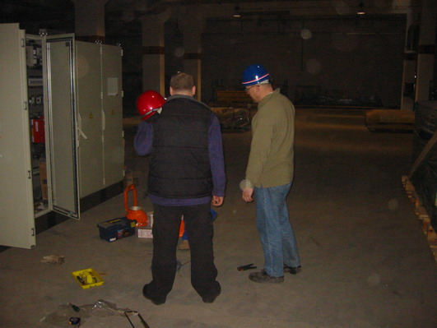
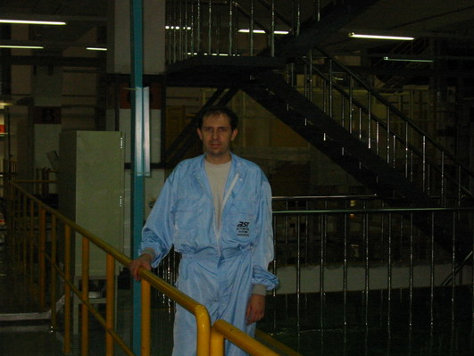
Engineering supervision of control installation assembly

Slide 9
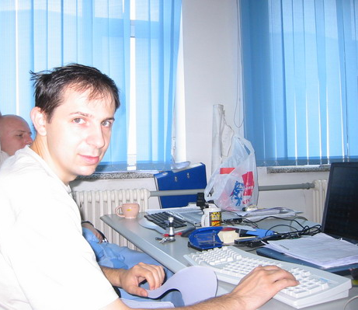
Preparing post-realization documentation (including revision)

Slide 10
There is coming our 20th anniversary of founded. We cooperated with many companies. Some of them You can find below:
‘ASI GmbH’ from Germany,
‘Eisenmann’ GmbH from Germany,
‘Simtech Automatyka Przemysłowa’ from Germany,
‘Pentanova’ from Austria,
‘Gamma Plus s.c.’ from Poland,
‘Aiut’ from Poland,
‘Eisberg’ from Poland,
‘Edag’ from Finland,
‘FFT’ from Germany.

Slide 11
Full list of finished projects with their range can be found on our website, where You can find also rest of important informations about „Automatyka Przemyslowa s.c.”.
English version:
References
Polish version:
Nasze projekty

Slide 12
e-mail: biuro@apsc.pl
59-220 Legnica ul. Anielewicza 3/1b
tel. +48 76 8523919 fax. +48 76 8501727
mobile +48601768441 +48603390313 +48603390314

